Slide 1
PAC learning
Lee-Ad Gottlieb

Slide 2

PAC Learning
Probably Approximately Correct
Coin example: with probability $1−δ$, the bias of the coin is $X±ε$.

Slide 3
PAC Learning
Probably Approximately Correct
Coin example: with probability $1−δ$, the bias of the coin is $X±ε$.
Probably
Approximately

Slide 4

PAC learning example
We observe a sample of n students (drawn uniformly at random) who were accepted and rejected to a certain program
We also know each student’s psychometric score. Assume this is the sole criterion.
Given a new random student and his psychometric score, can we guess if he will be admitted to the program?

Slide 5
PAC learning example
With equal probability, 1/n
We observe a sample of n students (drawn uniformly at random) who were accepted and rejected to a certain program
We also know each student’s psychometric score. Assume this is the sole criterion.
Given a new random student and his psychometric score, can we guess if he will be admitted to the program?

Slide 6
PAC learning example
Cutoff guess
The data looks like this:
The true cutoff must somewhere in the middle. What learning rule should we take?
Guess a cutoff. Left is reject, right is accept
Where should we put the threshold?
Leftmost? No false negatives.
Rightmost? No false positives.
something else?
Psychometric score
reject
accept

Slide 7
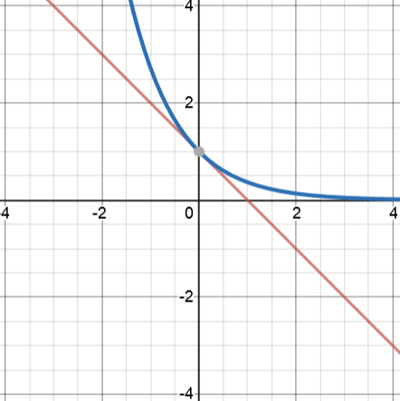
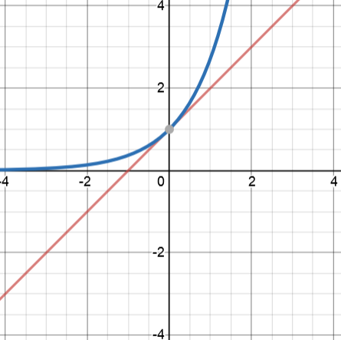
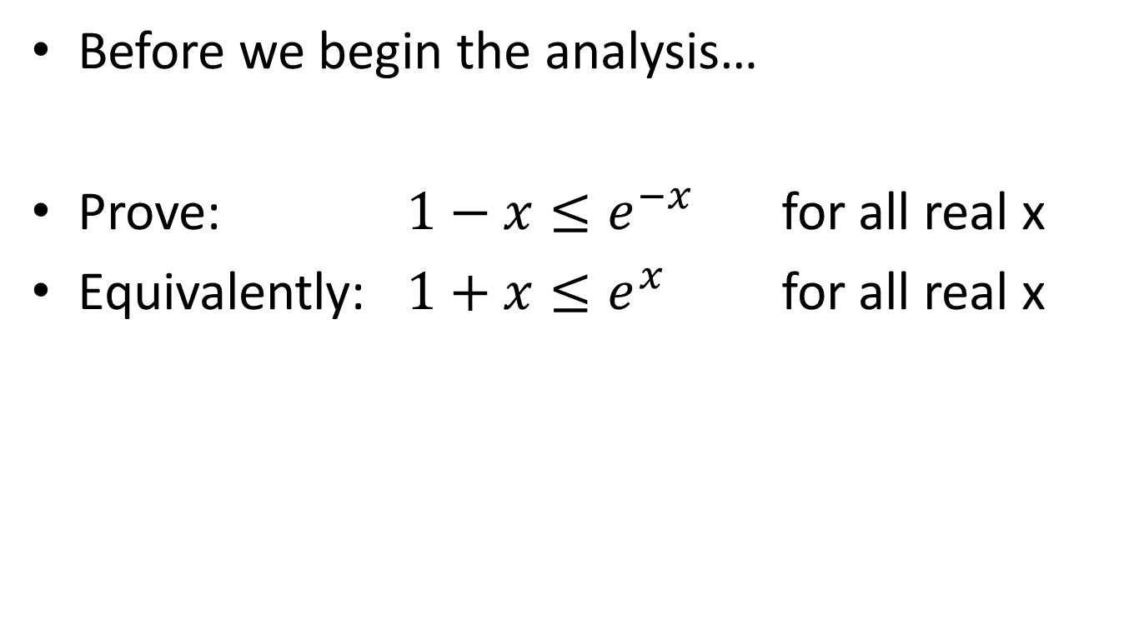
Preliminary
Before we begin the analysis…
Prove: $1−x≤e^{−x}$ for all real x
Equivalently: $1+x≤e^{x}$ for all real x

Slide 8
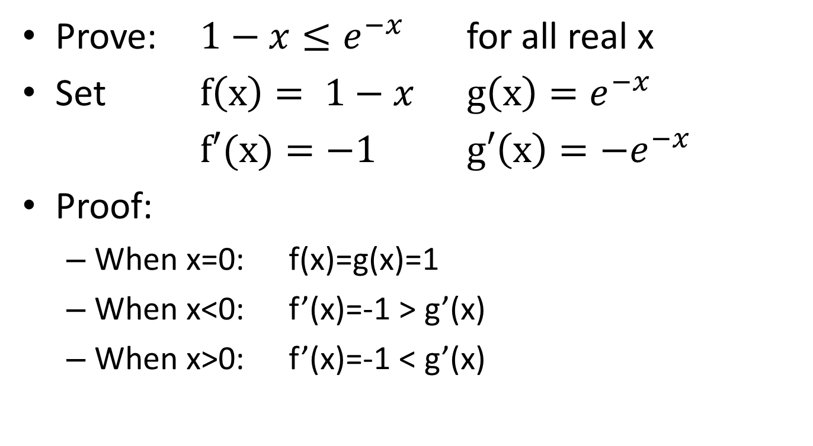
Preliminary
Prove: $1−x≤e^{−x}$ for all real x
Set $f\left(x\right)= 1−x$ $g\left(x\right)=e^{−x}$
$f′(x)=−1$ $g′\left(x\right)={−e}^{−x}$
Proof:
When x=0: f(x)=g(x)=1
When x<0: f’(x)=-1 > g’(x)
When x>0: f’(x)=-1 < g’(x)

Slide 9
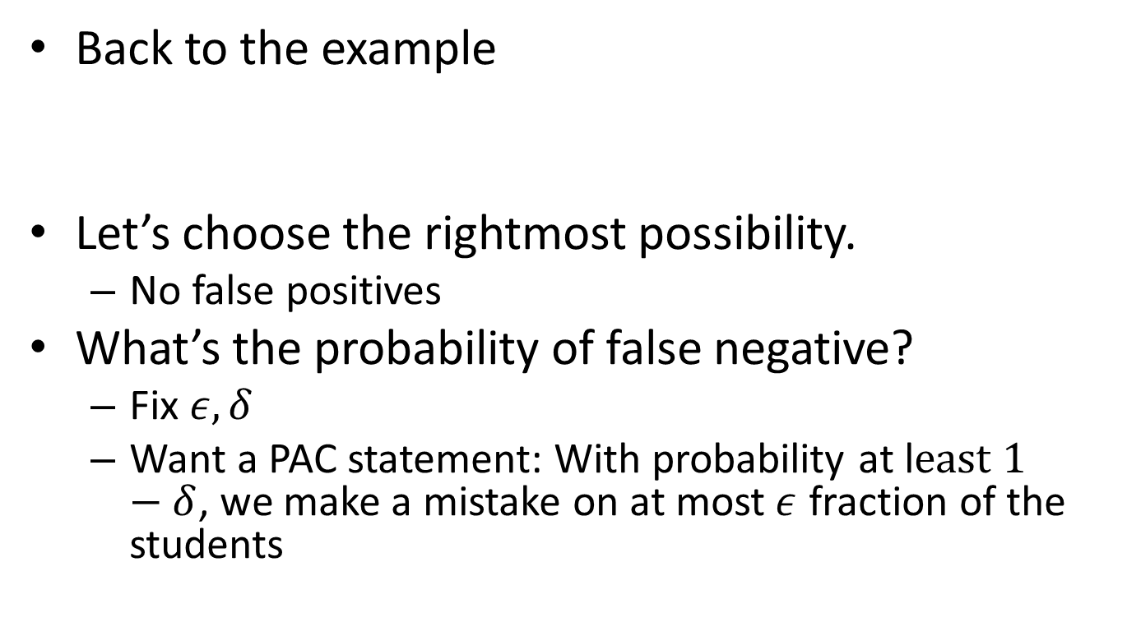
PAC learning example
Back to the example
Let’s choose the rightmost possibility.
No false positives
What’s the probability of false negative?
Fix $ε, δ$
Want a PAC statement: With probability at l$east 1−δ$, we make a mistake on at most$ε$ fraction of the students
truth
guess
reject
accept

Slide 10

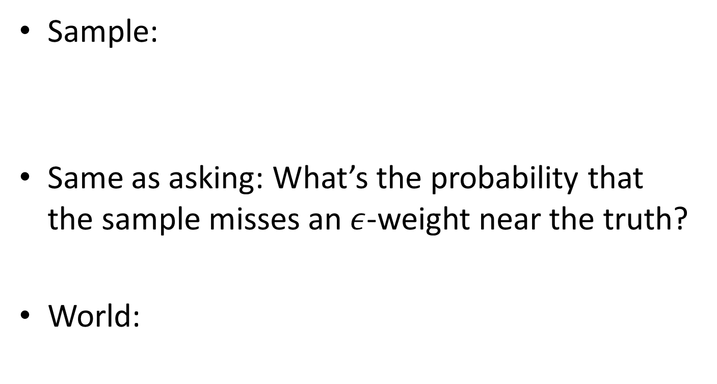
PAC learning example
Sample:
Same as asking: What’s the probability that the sample misses an $ε$-weight near the truth?
World:
truth
guess
reject
accept
truth
reject
accept
$$ε$$

Slide 11
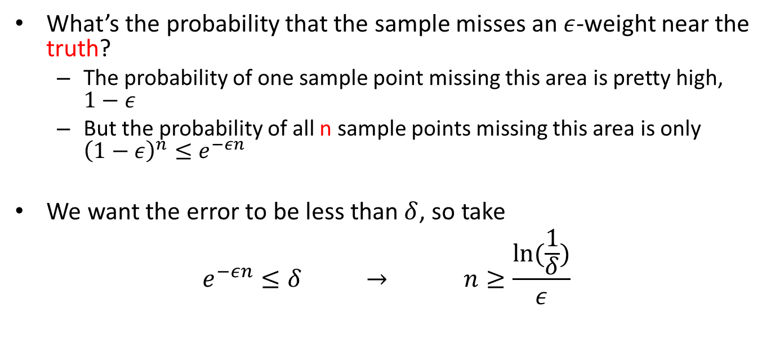
PAC learning example
What’s the probability that the sample misses an $ε$-weight near the truth?
The probability of one sample point missing this area is pretty high, $1−ε$
But the probability of all n sample points missing this area is only ${\left(1−ε\right)}^{n}≤e^{−εn}$
We want the error to be less than $δ$, so take
$$e^{−εn}≤δ → n≥\frac{ln⁡(\frac{1}{δ})}{ε}$$
truth
reject
accept
$$ε$$

Slide 12

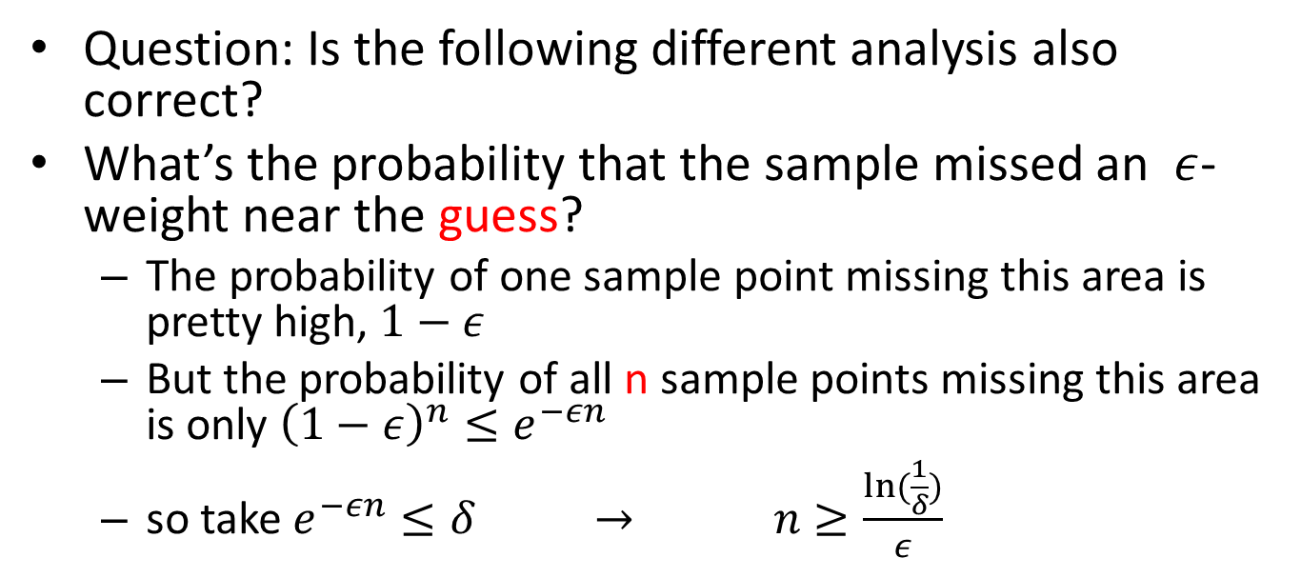
PAC learning example
Question: Is the following different analysis also correct?
What’s the probability that the sample missed an $ε$-weight near the guess?
The probability of one sample point missing this area is pretty high, $1−ε$
But the probability of all n sample points missing this area is only ${\left(1−ε\right)}^{n}≤e^{−εn}$
so take $e^{−εn}≤δ → n≥\frac{ln⁡(\frac{1}{δ})}{ε}$
guess
reject
accept
$$ε$$

Slide 13
PAC learning example
Question: Is the following different analysis also correct?
No, guess is determined after the sample.
Sample dependent.
Fix: could multiply probability by number of possible guesses.
But this could be large.
guess
reject
accept
$$ε$$

Slide 14
PAC learning example
Extend the previous 1-D example to 2-D
Let our rules be rectangles.
Ex: Sample of baby height, weight

Slide 15
PAC learning example
Extend the previous 1-D example to 2-D
Let our rules be rectangles.
Ex: Sample of baby height, weight
truth
guess

Slide 16
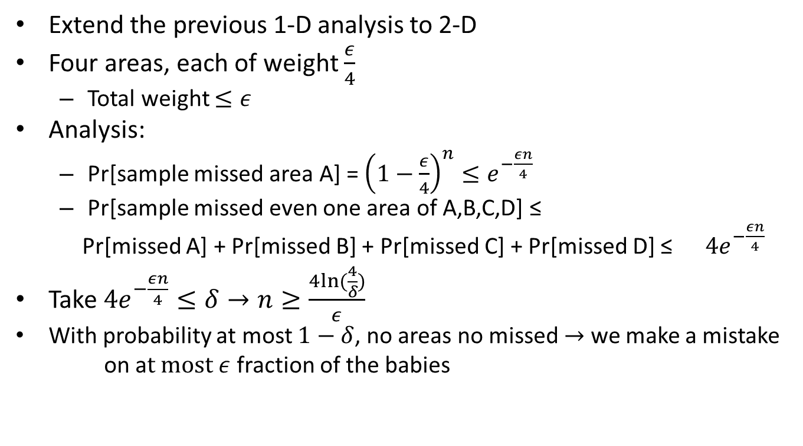
PAC learning example
Extend the previous 1-D analysis to 2-D
Four areas, each of weight $\frac{ε}{4}$
Total weight $≤ε$
Analysis:
Pr[sample missed area A] = ${\left(1−\frac{ε}{4}\right)}^{n}≤e^{−\frac{εn}{4}}$
Pr[sample missed even one area of A,B,C,D] ≤
Pr[missed A] + Pr[missed B] + Pr[missed C] + Pr[missed D] ≤ ${ 4e}^{−\frac{εn}{4}}$
Take ${4e}^{−\frac{εn}{4}}≤δ→n≥\frac{4ln⁡(\frac{4}{δ})}{ε}$
With probability at most $1−δ$, no areas no missed $→$ we make a mistake
on a$t most ε$ fraction of the babies
Union bound
A
B
C
D

Slide 17
PAC learning example
What if our rules are circles?
Here’s our sample

Slide 18

PAC learning example
What if our rules are circles?
Here’s our sample and guess
guess
truth

Slide 19
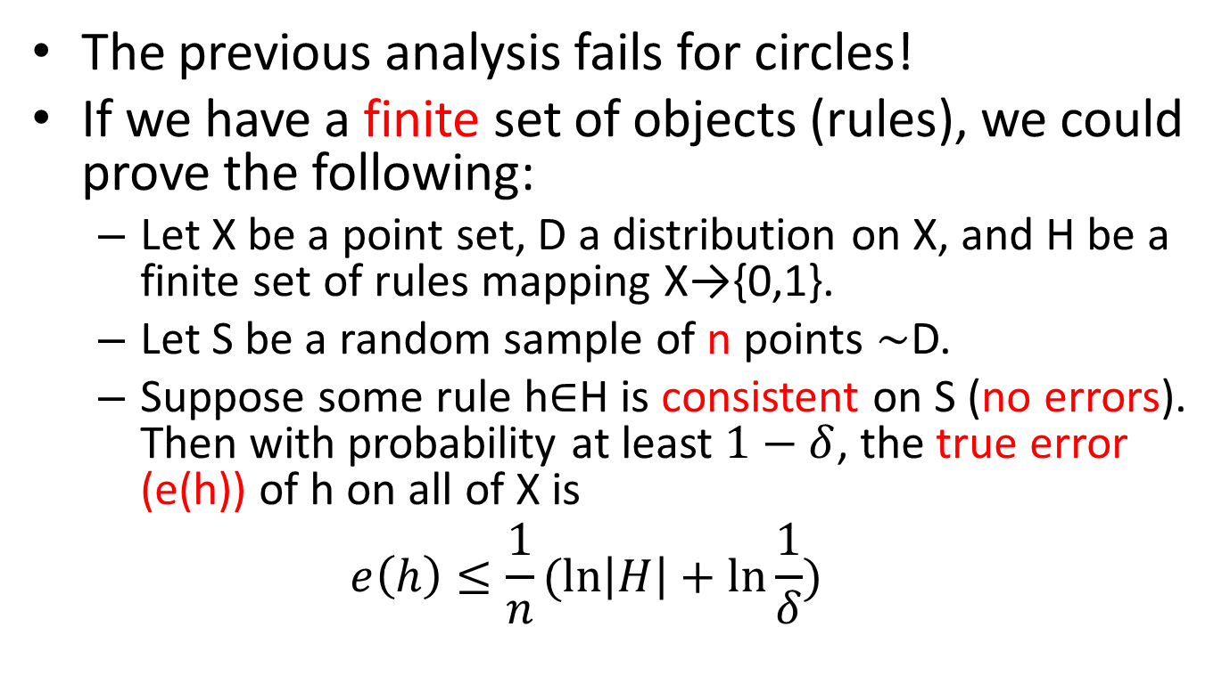
Generalization bound
The previous analysis fails for circles!
If we have a finite set of objects (rules), we could prove the following:
Let X be a point set, D a distribution on X, and H be a finite set of rules mapping X→{0,1}.
Let S be a random sample of n points $\sim$D.
Suppose some rule h$∈$H is consistent on S (no errors). Then with probability at least $1−δ$, the true error (e(h)) of h on all of X is
$$e\left(h\right)≤\frac{1}{n}(\ln\left|H\right|+\ln{\frac{1}{δ})}$$

Slide 20
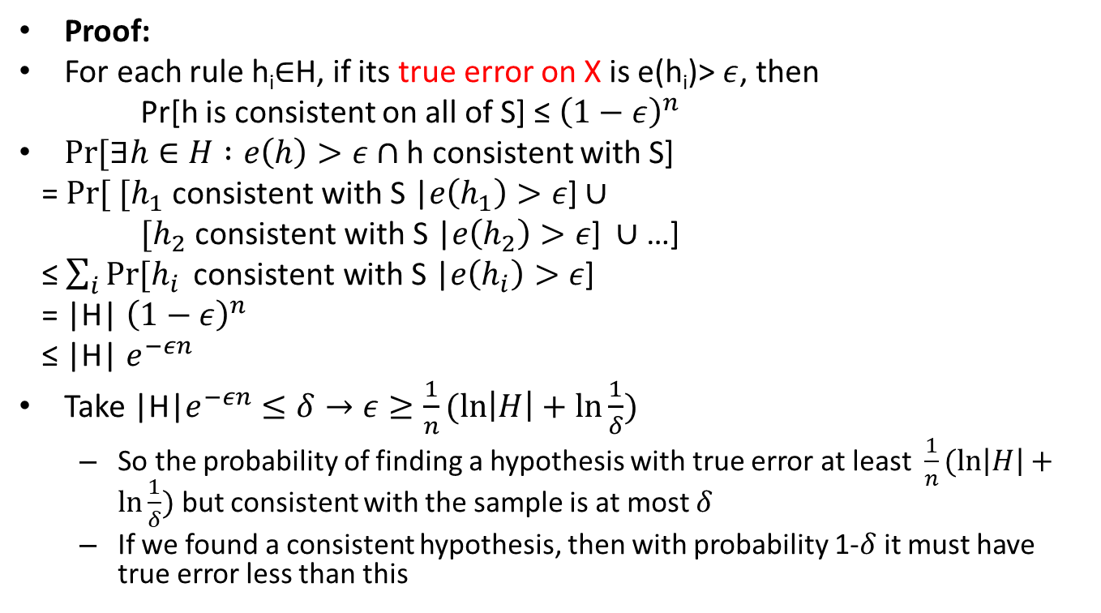
Generalization bound
Proof:
For each rule h_{i}$∈$H, if its true error on X is e(h_{i})> $ε$, then
Pr[h is consistent on all of S] ≤ ${\left(1−ε\right)}^{n}$
$Pr⁡[∃h∈H :e\left(h\right)>ε∩$ h consistent with S]
= $Pr⁡[ [h_{1} \text{consistent} \text{with} \text{S}\text{ |}e\left(h_{1}\right)>ε\text{]}∪$
$[h_{2} \text{consistent} \text{with} \text{S}\text{ |}e\left(h_{2}\right)>ε\text{]} ∪$ …]
≤ $\sum_{i}{Pr⁡[h_{i}} \text{consistent} \text{with} \text{S}\text{ |}e\left(h_{i}\right)>ε\text{]}$
= |H| ${\left(1−ε\right)}^{n}$
≤ |H| $e^{−εn}$
Take |H|$e^{−εn}≤δ→ε≥\frac{1}{n}(\ln\left|H\right|+\ln{\frac{1}{δ})}$
So the probability of finding a hypothesis with true error at least $\frac{1}{n}(\ln\left|H\right|+\ln{\frac{1}{δ})}$ but consistent with the sample is at most $δ$
If we found a consistent hypothesis, then with probability 1-$δ$it must have true error less than this
Conditional
probability
Union bound

Slide 21
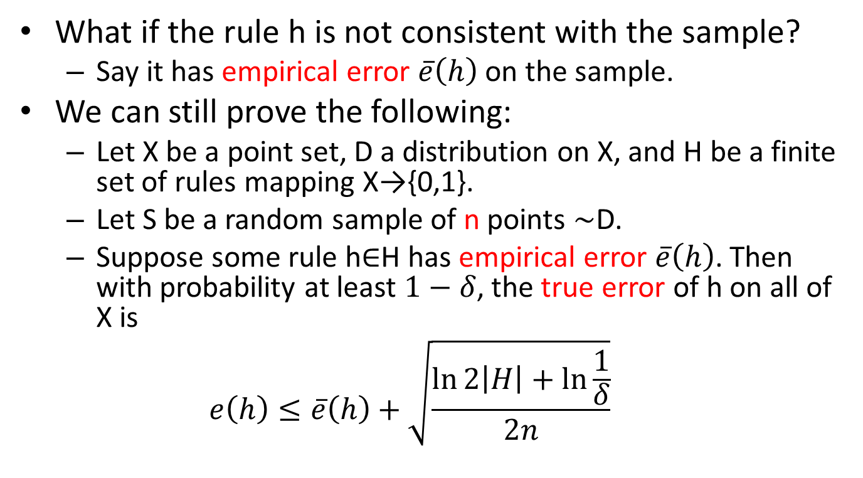
Generalization bound
What if the rule h is not consistent with the sample?
Say it has empirical error $\overline{e}\left(h\right)$on the sample.
We can still prove the following:
Let X be a point set, D a distribution on X, and H be a finite set of rules mapping X→{0,1}.
Let S be a random sample of n points $\sim$D.
Suppose some rule h$∈$H has empirical error $\overline{e}\left(h\right)$. Then with probability at least $1−δ$, the true error of h on all of X is
$$e\left(h\right)≤\overline{e}\left(h\right)+\sqrt{\frac{\ln{2\left|H\right|}+\ln{\frac{1}{δ}}}{2n}}$$

Slide 22
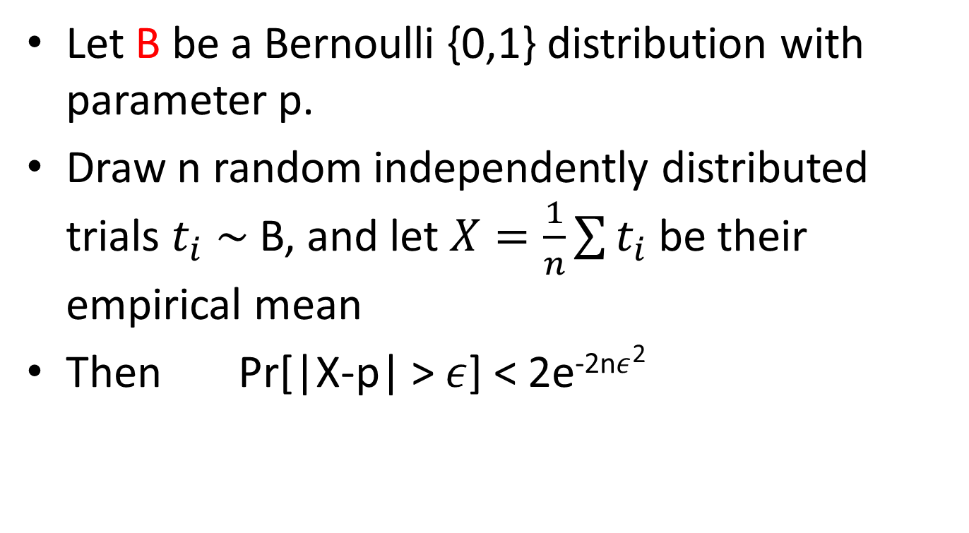
Hoeffding’s inequality
Let B be a Bernoulli {0,1} distribution with parameter p.
Draw n random independently distributed trials $t_{i}$ $\sim$ B, and let $X=\frac{1}{n}\sum{t_{i}}$ be their empirical mean
Then Pr[|X-p| > $ε$] < 2e^{-2n}$ε$²

Slide 23
Hoeffding’s inequality
Let B be a Bernoulli {0,1} distribution with parameter p.
Draw n random independently distributed trials $t_{i}$ $\sim$ B, and let $X=\frac{1}{n}\sum{t_{i}}$ be their empirical mean
Then Pr[|X-p| > $ε$] < 2e^{-2n}$ε$²
E[X]

Slide 24
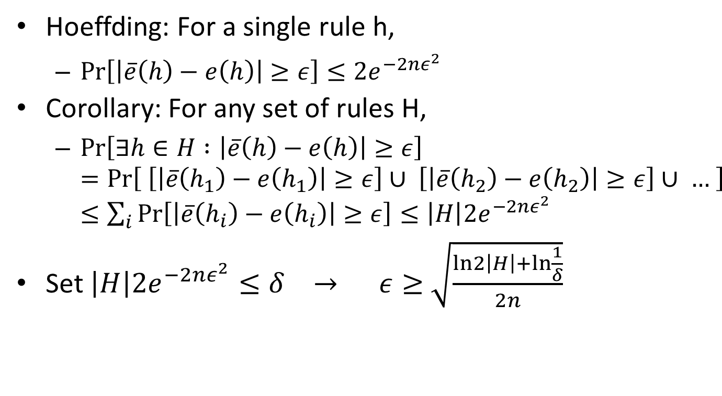
Generalization bound
Hoeffding: For a single rule h,
$\operatorname{Pr}\left[\left|\overline{e}\left(h\right)−e\left(h\right)\right|≥ε\right]≤2e^{−2nε^{2}}$
Corollary: For any set of rules H,
$\operatorname{Pr}\left[∃h∈H :\left|\overline{e}\left(h\right)−e\left(h\right)\right|≥ε\right]=Pr\left[ \left[\left|\overline{e}\left(h_{1}\right)−e\left(h_{1}\right)\right|≥ε\right]∪ \left[\left|\overline{e}\left(h_{2}\right)−e\left(h_{2}\right)\right|≥ε\right]∪ … \right]≤\sum_{i}{Pr⁡\left[\left|\overline{e}\left(h_{i}\right)−e\left(h_{i}\right)\right|≥ε\right]}≤\left|H\right|2e^{−2nε^{2}}$
Set $\left|H\right|2e^{−2nε^{2}}≤δ → ε≥$ $\sqrt{\frac{ln2\left|H\right|+\ln{\frac{1}{δ}}}{2n}}$

Slide 25
PAC learning
But what if we have an infinite set of rules, like circles?
Need more advanced tools.
Shattering
VC-dimension

Slide 26
PAC learning
What can’t we learn? Challenge can be:
Statistical: Take the distribution which assigns each point {0,1} with probability ½.
This can’t be learned.
Computational: Take a distribution over graphs. We want to learn what percentage of the graphs are 3-colorable.
Determining whether a graph is 3-colorable is NP-hard.

